Slide 1

Advanced Analytical Theory and Methods: Time Series Analysis
Author : FU
Date : Mar-2022

Slide 2
Objectives
After studying this chapter, the student should be able to understand the key concepts:
ACF - Autocorrelation Function
ARIMA - Autoregressive Integrated Moving Average Model
Autoregressive
Moving Average
PACF - Partial Autocorrelation Function
Stationary
Time series

Slide 3
Content
1. Overview of Time Series Analysis
2. ARIMA Model
3. Additional Methods

Slide 4
1 Overview of Time Series Analysis
Time series analysis attempts to model the underlying structure of observations taken over time
A time series, denoted Y =a+bX , is an ordered sequence of equally spaced values over time
Goals of time series analysis
Identify and model the structure of the time series.
Forecast future values in the time series.
FIGURE 8-1 Monthly international airline passengers

Slide 5
1.1 Box-Jenkins Methodology 1/2
A time series consists of an ordered sequence of equally spaced values over time.
A time series can consist of the following components: Trend, Seasonality, Cyclic, Random
Trend refers to the long-term movement in a time series
Seasonality component describes the fixed, periodic fluctuation in the observations over time
Cyclic component also refers to a periodic fluctuation, but one that is not as fixed as in the case of a seasonality component
Random component is what remains After accounting for the other three components

Slide 6
1.1 Box-Jenkins Methodology 2/2
Box-Jenkins methodology (developed by George Box and Gwilym Jenkins) for time series analysis involves the following three main steps:
1. Condition data and select a model.
Identify and account for any trends or seasonality in the time series.
Examine the remaining time series and determine a suitable model.
2. Estimate the model parameters.
3. Assess the model and return to Step 1, if necessary.

Slide 7
2 ARIMA Model 1/3
In the first step of the Box-Jenkins methodology, it is necessary to remove any trends or seasonality in the time series, to achieve a time series with certain properties to which autoregressive and moving average models can be applied.
Such a time series is known as a stationary time series. A time series, y_{t} for t=1,2,3,...,, is a stationary time series if the following three conditions are met:
(a) Expected value (mean) of y_{t} is a constant for all values of t.
(b) Variance of y_{t} is finite.
(c) Covariance of y_{t} and y_{t +h} depends only on the value of h=0,1, 2, . . .for all t
Covariance of y_{t} and y_{t +h} is a measure of how the two variables, y_{t} and y_{t +h}, vary together. (Equation 8-1)
Notes:
stationary time series
ARIMA (Autoregressive Integrated Moving Average) model

Slide 8
2 ARIMA Model 2/3
If two variables are independent → their covariance is zero.
If variables change together in the same direction, variables have a positive covariance.
if variables change together in the opposite direction, variables have a negative covariance.
For a stationary time series, by condition (a), mean is a constant, μ. So, for a given stationary sequence, y_{t} , covariance notation can be simplified like Equation 8-2.
By part (c), the covariance between two points in the time series can be nonzero, as long as the value of the covariance is only a function of h. Equation 8-3 is an example for h=3.

Slide 9
2 ARIMA Model 3/3
It is important to note that for h=0, the cov(0) = cov(y_{t}, y_{t}) = var(y_{t}) for all t.
Because the var(y_{t})<∞, by condition (b), the variance of y_{t} is a constant for all t.
So the constant variance coupled with part (a), E[y_{t}]=μ, for all t and some constant μ, suggests that a stationary time series can look like Figure 8-2. In this plot, the points appear to be centered about a fixed constant, zero, and the variance appears to be somewhat constant over time.

Slide 10
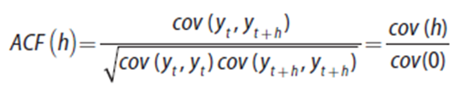

2.1 Autocorrelation Function (ACF) 1/3
Plot of autocorrelation function (ACF) provides this insight.
For a stationary time series, the ACF is defined as shown in Equation 8-4.
FIGURE 8-2 A plot of a stationary series

Slide 11
2.1 Autocorrelation Function (ACF) 2/3
Because cov(0) is the variance, ACF is analogous to the correlation function of two variables, corr(y_{t}, y_{t + h}), and value of ACF falls between –1 and 1.
The closer the absolute value of ACF(h) is to 1, the more useful y_{t}, can be as a predictor of y_{t+h} .
Using the same dataset plotted in Figure 8-2, the plot of the ACF is provided in Figure 8-3.
FIGURE 8-3 Autocorrelation function (ACF)

Slide 12
2.1 Autocorrelation Function (ACF) 3/3
lag: quantity h in the ACF, difference between the time points t and t + h.
At lag 0, ACF provides correlation of every point with itself. So ACF(0) always equals 1.
According to ACF plot, at lag 1 the correlation between y_{t} and y_{t−1} is approximately 0.9, which is very close to 1. So y_{t−1} appears to be a good predictor of the value of y_{t} .
Because ACF(2) is around 0.8, y_{t−2} appears to be a good predictor of the value of y_{t} . A similar argument could be made for lag 3 to lag 8. (All he autocorrelations are greater than 0.6.)
In other words, a model can be considered that would express y_{t} as a linear sum of its previous 8 terms. Such a model is known as an autoregressive model of order 8.

Slide 13
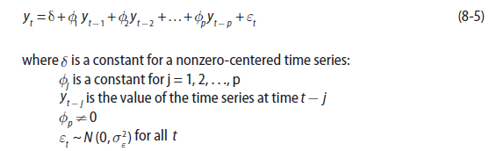
2.2 Autoregressive Models 1/5
For a stationary time series, y_{t} t=1, 2, 3,… , an autoregressive model of order p, denoted AR(p), is expressed as shown in Equation 8-5:
A particular point in the time series can be expressed as a linear combination of prior p values, y_{t− j} for j = 1, 2, . . . p, of the time series plus a random error term, ε_{t} .
In this definition, ε_{t} time series is often called a white noise process and is used to represent random, independent fluctuations that are part of the time series.

Slide 14


2.2 Autoregressive Models 2/5
The autocorrelations are quite high for the first several lags.
Although it appears that an AR(8) model might be a good candidate to consider for the given dataset, examining an AR(1) model provides further insight into the ACF and the appropriate value of p to choose.
For an AR(1) model, centered around δ=0, Equation 8-5 simplifies to Equation 8-6.
Based on Equation 8-6, it is evident that y_{t-1} =φ₁ y_{t-2} +ε . substituting for y_{t−1} yields Equation 8-7.

Slide 15
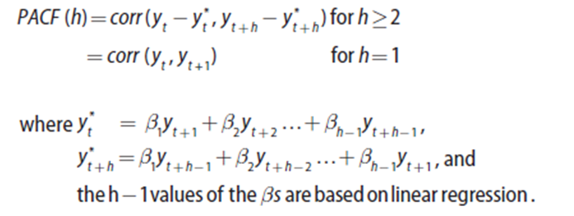
2.2 Autoregressive Models 3/5
Follows an AR(1) model, considerable autocorrelation is expected at lag 2. As this substitution process is repeated, y_{t} can be expressed as a function of y_{t−h} for h=3, 4 ...and a sum of the error terms
This observation means that even in the simple AR(1) model, there will be considerable autocorrelation with the larger lags even though those lags are not explicitly included in the model.
What is needed is a measure of the autocorrelation between y_{t} and y_{t+h} for h = 1, 2, 3... with the effect of the y_{t+1} to y_{t+h−1} values excluded from the measure.
The partial autocorrelation function (PACF) provides such a measure and is expressed as shown in Equation 8-8.
8-8

Slide 16
2.2 Autoregressive Models 4/5
After linear regression is used to remove the effect of the variables between y_{t} and y_{t+h} on y_{t} and y_{t+h}, the PACF is the correlation of what remains.
For h=1, there are no variables between y_{t} and y_{t+1}. So the PACF(1) equals ACF(1). Although the computation of the PACF is somewhat complex, many software tools hide this complexity from the analyst.
PACF plot in Figure 8-4 illustrates that after lag 2, the value of the PACF is sharply reduced.
After removing the effects of y_{t +1} and y_{t +2}, the partial correlation between y_{t} and y_{t+3} is relatively small.
FIGURE 8-4 Partial autocorrelation function (PACF) plot

Slide 17
2.2 Autoregressive Models 5/5
Similar observations can be made for h = 4, 5, …. Such a plot indicates that an AR(2) is a good candidate model for the time series plotted in Figure 8-2.
The time series data for this example was randomly generated based on y_{t} =0.6y_{t-1} + 0.35y_{t-2} + ε where ε_{t} ~N(0, 4)
Because the ACF and PACF are based on correlations, negative and positive values are possible. Thus, the magnitudes of the functions at the various lags should be considered in terms of absolute values.

Slide 18
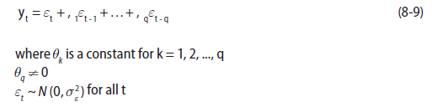
2.3 Moving Average Models 1/4
For a time series, y_{t} , centered at zero, a moving average model of order q, denoted MA(q), is expressed as shown in Equation 8-9.
In an MA(q) model, the value of a time series is a linear combination of the current white noise term and the prior q white noise terms. So earlier random shocks directly affect the current value of the time series.
For MA(q) models, the behavior of the ACF and PACF plots are somewhat swapped from the behavior of these plots for AR(p) models.

Slide 19
2.3 Moving Average Models 2/4
For a simulated MA(3) time series of the form
y_{t} = ε_{t} - 0.4ε_{t-1} + 1.1ε_{t-2} - 2.5ε_{t-3}
where ε_{t} ~N(0,1)
Figure 8-5 provides the scatterplot of the simulated data over time.
FIGURE 8-5 Scatterplot of a simulated MA(3) time series

Slide 20
2.3 Moving Average Models 3/4
Figure 8-6 provides the ACF plot for the simulated data. Again, the ACF(0) equals 1, because any variable is perfectly correlated with itself.
At lags 1, 2, and 3, the value of the ACF is relatively large in absolute value compared to the subsequent terms.
In an autoregressive model, the ACF slowly decays, but for an MA(3) model, the ACF somewhat abruptly cuts off after lag 3. In general, this pattern can be extended to any MA(q) model.
FIGURE 8-6 ACF plot of a simulated MA(3) time series

Slide 21
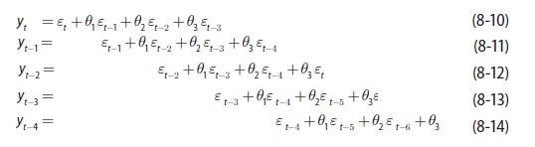
2.3 Moving Average Models 4/4
Equations 8-10 through 8-14 for an MA(3) time series model:
.

Slide 22
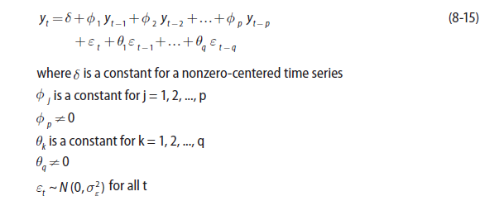
2.4 ARMA and ARIMA Models 1/6
It is often useful to combine these two representations into one model.
Combination of these two models for a stationary time series results in an Autoregressive Moving Average model, ARMA(p,q), expressed in Equation 8-15.

Slide 23
2.4 ARMA and ARIMA Models 2/6
If p=0 and q≠0, then the ARMA(p,q) model is simply an AR(p) model. Similarly, if p=0 andq≠0, then the ARMA(p, q) model is an MA(q) model.
To apply an ARMA model properly, the time series must be a stationary one. However, many time series exhibit some trend over time. Figure 8-7 illustrates a time series with an increasing linear trend over time.
FIGURE 8-7 A time series with a trend

Slide 24
2.4 ARMA and ARIMA Models 3/6
If detrending using a linear or higher order regression model does not provide a stationary series, a second option is to compute the difference between successive y-values. This is known as differencing or for the n values in a given time series compute the differences as shown in Equation 8-16.
The mean of the time series plotted in Figure 8-8 is certainly not a constant.
Applying differencing to the time series results in the plot in Figure 8-9.
This plot illustrates a time series with a constant mean and a fairly constant variance over time.
FIGURE 8-8 Time series for differencing example

Slide 25

2.4 ARMA and ARIMA Models 4/6
If the differenced series is not reasonably stationary, applying differencing additional times may help. Equation 8-17 provides the twice differenced time series for t = 3, 4, …n.
FIGURE 8-9 Detrended time series using differencing

Slide 26
2.4 ARMA and ARIMA Models 5/6
Because the need to make a time series stationary is common, the differencing can be included (integrated) into the ARMA model definition by defining the Autoregressive Integrated Moving Average model, denoted ARIMA(p,d,q).
The structure of the ARIMA model is identical to the expression in Equation 8-15, but the ARMA(p,q) model is applied to the time series, y_{t}, after applying differencing d times.
FIGURE 8-10 Twice differenced series

Slide 27
2.4 ARMA and ARIMA Models 6/6
Similar to the earlier option of detrending a series by first applying linear regression, the seasonal pattern could be determined and the time series appropriately adjusted. An alternative is to use a seasonal autoregressive integrated moving average model, denoted ARIMA(p,d,q) × (P,D,Q)_{s} where:
p, d, and q are the same as defined previously.
s denotes the seasonal period.
P is the number of terms in the AR model across the s periods.
D is the number of differences applied across the s periods.
Q is the number of terms in the MA model across the s periods.
For a time series with a seasonal pattern, following are typical values of s:
52 for weekly data
12 for monthly data
7 for daily data

Slide 28
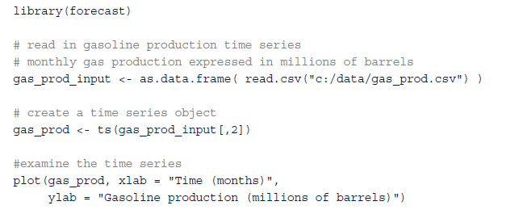
2.5 Building and Evaluating an ARIMA Model 1/11
For a large country, the monthly gasoline production measured in millions of barrels has been obtained for the past 240 months (20 years). A market research firm requires some short-term gasoline production forecasts to assess the petroleum industry’s ability to deliver future gasoline supplies and the effect on gasoline prices

Slide 29
2.5 Building and Evaluating an ARIMA Model 2/11
Using R, the dataset is plotted in Figure 8-11.
FIGURE 8-11 Monthly gasoline production

Slide 30
2.5 Building and Evaluating an ARIMA Model 3/11
In R, the ts() function creates a time series object from a vector or a matrix. The use of time series objects in R simplifies the analysis by providing several methods that are tailored specifically for handling equally time spaced data series. For example, the plot() function does not require an explicitly specified variable for the x-axis.
plot(diff(gas_prod))
abline(a=0, b=0)
FIGURE 8-12 Differenced gasoline production time series

Slide 31

2.5 Building and Evaluating an ARIMA Model 4/11
Differenced time series has a constant mean near zero with a fairly constant variance over time. Thus, a stationary time series has been obtained. Using the following R code, the ACF and PACF plots for the differenced series are provided in Figures 8-13 and 8-14, respectively.
FIGURE 8-14 PACF of the differenced gasoline time series
FIGURE 8-13 ACF of the differenced gasoline time series

Slide 32
2.5 Building and Evaluating an ARIMA Model 5/11
The dashed lines provide upper and lower bounds at a 95% significance level. Any value of the ACF or PACF outside of these bounds indicates that the value is significantly different from zero.
Figure 8-13 shows several significant ACF values. The slowly decaying ACF values at lags 12, 24, 36, and 48 are of particular interest. A similar behavior in the ACF was seen in Figure 8-3, but for lags 1, 2, 3,…
Figure 8-13 indicates a seasonal autoregressive pattern every 12 months. Examining the PACF plot in Figure 8-14, the PACF value at lag 12 is quite large, but the PACF values are close to zero at lags 24, 36, and 48.
Thus, a seasonal AR(1) model with period = 12 will be considered. It is often useful to address the seasonal portion of the overall ARMA model before addressing the nonseasonal portion of the model.

Slide 33
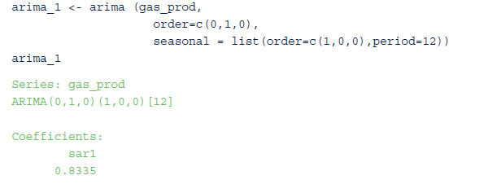

2.5 Building and Evaluating an ARIMA Model 6/11
The arima() function in R is used to fit a (0,1,0) × (1,0,0)12 model. The analysis is applied to the original time series variable, gas_prod. The differencing, d = 1, is specified by the order = c(0,1,0) term.

Slide 34

2.5 Building and Evaluating an ARIMA Model 7/11
The value of the coefficient for the seasonal AR(1) model is estimated to be 0.8335 with a standard error of 0.0324. Because the estimate is several standard errors away from zero, this coefficient is considered significant. The output from this first pass ARIMA analysis is stored in the variable arima_1, which contains several useful quantities including the residuals.
The next step is to examine the residuals from fitting the (0,1,0) × (1,0,0)12 ARIMA model. The ACF and PACF plots of the residuals are provided in Figures 8-15 and 8-16, respectively.

Slide 35
2.5 Building and Evaluating an ARIMA Model 8/11
The ACF plot of the residuals in Figure 8-15 indicates that the autoregressive behavior at lags 12, 24, 26, and 48 has been addressed by the seasonal AR(1) term.
The only remaining ACF value of any significance occurs at lag 1. In Figure 8-16, there are several significant PACF values at lags 1, 2, 3, and 4. Because the PACF plot in Figure 8-16 exhibits a slowly decaying PACF, and the ACF cuts off sharply at lag 1, an MA(1) model should be considered for the nonseasonal portion of the ARMA model on the differenced series.
In other words, a (0,1,1) × (1,0,0)₁₂ ARIMA model will be fitted to the original gasoline production time series.
FIGURE 8-15 ACF of residuals from seasonal AR(1) model

Slide 36
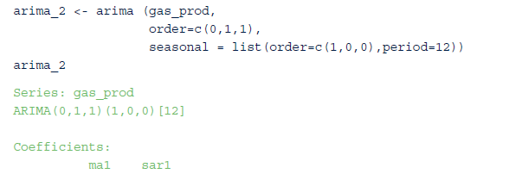
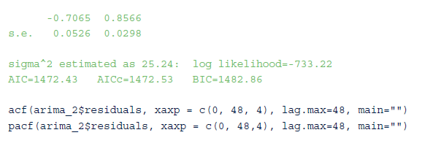
2.5 Building and Evaluating an ARIMA Model 9/11
FIGURE 8-16 PACF of residuals from seasonal AR(1) model

Slide 37
2.5 Building and Evaluating an ARIMA Model 10/11
Based on the standard errors associated with each coefficient estimate, the coefficients are significantly different from zero. In Figures 8-17 and 8-18, the respective ACF and PACF plots for the residuals from the second pass ARIMA model indicate that no further terms need to be considered in the ARIMA model.
FIGURE 8-17 ACF for the residuals from the (0,1,1) × (1,0,0)₁₂ model
FIGURE 8-18 PACF for the residuals from the (0,1,1) × (1,0,0)₁₂ model

Slide 38
2.5 Building and Evaluating an ARIMA Model 11/11
It should be noted that the ACF and PACF plots each have several points that are close to the bounds at a 95% significance level. However, these points occur at relatively large lags.
To avoid overfitting the model, these values are attributed to random chance. So no attempt is made to include these lags in the model. However, it is advisable to compare a reasonably fitting model to slight variations of that model.

Slide 39
Comparing Fitted Time Series Models 1/2
arima() function uses Maximum Likelihood Estimation (MLE) to estimate the model coefficients.
In the R output for an ARIMA model, the log-likelihood (logL) value is provided. The values of the model coefficients are determined such that the value of the log likelihood function is maximized. Based on the log L value, the R output provides several measures that are useful for comparing the appropriateness of one fitted model against another fitted model. These measures follow:
AIC (Akaike Information Criterion)
AICc (Akaike Information Criterion, corrected)
BIC (Bayesian Information Criterion)
Because these criteria impose a penalty based on the number of parameters included in the models, the preferred model is the fitted model with the smallest AIC, AICc, or BIC value.

Slide 40
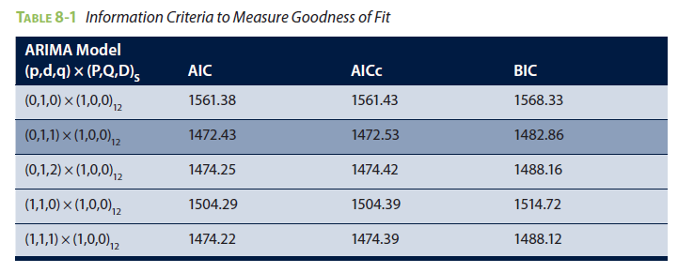
Comparing Fitted Time Series Models 2/2
In this dataset, the (0,1,1) × (1,0,0)12 model does have the lowest AIC, AICc, and BIC values compared to the same criterion measures for the other ARIMA models.

Slide 41
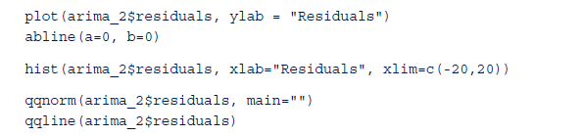

Normality and Constant Variance 1/2
The last model validation step is to examine the normality assumption of the residuals in Equation 8-15..”

Slide 42
Normality and Constant Variance 2/2
If the normality or the constant variance assumptions do not appear to be true, it may be necessary to transform the time series prior to fitting the ARIMA model. A common transformation is to apply a logarithm function.

Slide 43
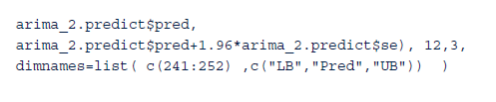
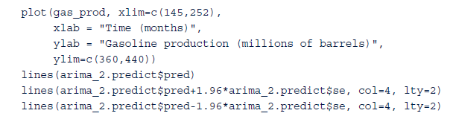
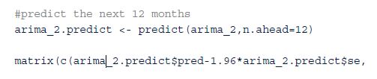
Forecasting
The next step is to use the fitted (0,1,1) × (1,0,0)12 model to forecast the next 12 months of gasoline production. In R, the forecasts are easily obtained using the predict() function and the fitted model already stored in the variable arima_2. The predicted values along with the associated upper and lower bounds at a 95% confidence level are displayed in R and plotted in Figure 8-22.
FIGURE 8-22 Actual and forecasted gasoline production

Slide 44
2.6 Reasons to Choose and Cautions 1/2
Can be based simply on historical time series data for the variable of interest.
ARIMA modeling ignores any additional input variables, the forecasting process is simplified
If regression analysis was used to model gasoline production, input variables such as Gross Domestic Product (GDP), oil prices, and unemployment rate may be useful input variables. However, to forecast the gasoline production using regression, predictions are required for GDP, oil price, and unemployment rate input variables.

Slide 45
2.6 Reasons to Choose and Cautions 2/2
Minimal data requirement, the model does not provide an indication of what underlying variables affect the outcome.
For example, if ARIMA modeling was used to forecast future retail sales, the fitted model would not provide an indication of what could be done to increase sales. In other words, causal inferences cannot be drawn from the fitted ARIMA model.
Using time series analysis is the impact of severe shocks to the system.
In the gas production example, shocks might include refinery fires, international incidents, or weather-related impacts such as hurricanes. Such events can lead to short-term drops in production, followed by persistently high increases in production to compensate for the lost production or to simply capitalize on any price increases.

Slide 46
3 Additional Methods
Autoregressive Moving Average with Exogenous inputs (ARMAX) is used to analyze a time series that is dependent on another time series
Spectral analysis is commonly used for signal processing and other engineering applications.
Generalized Autoregressive Conditionally Heteroscedastic (GARCH) is a useful model for addressing time series with nonconstant variance or volatility.
Kalman filtering is useful for analyzing real-time inputs about a system that can exist in certain tates.
Multivariate time series analysis examines multiple time series and their effect on each other. Vector ARIMA (VARIMA) extends ARIMA by considering a vector of several time series at a particular time, t.

Slide 47
Summary
Presented time series analysis using ARIMA models. Different from other statistical techniques in the sense that most statistical analyses assume the observations are independent of each other. Time series analysis implicitly addresses the case in which any particular observation is somewhat dependent on prior observations.
Using differencing, ARIMA models allow nonstationary series to be transformed into stationary series to which seasonal and nonseasonal ARMA models can be applied.
The importance of using the ACF and PACF plots to evaluate the autocorrelations was illustrated in determining ARIMA models to consider fitting.
Akaike and Bayesian Information Criteria can be used to compare one fitted ARIMA model against another.
Once an appropriate model has been determined, future values in the time series can be forecasted.

